Slide 1
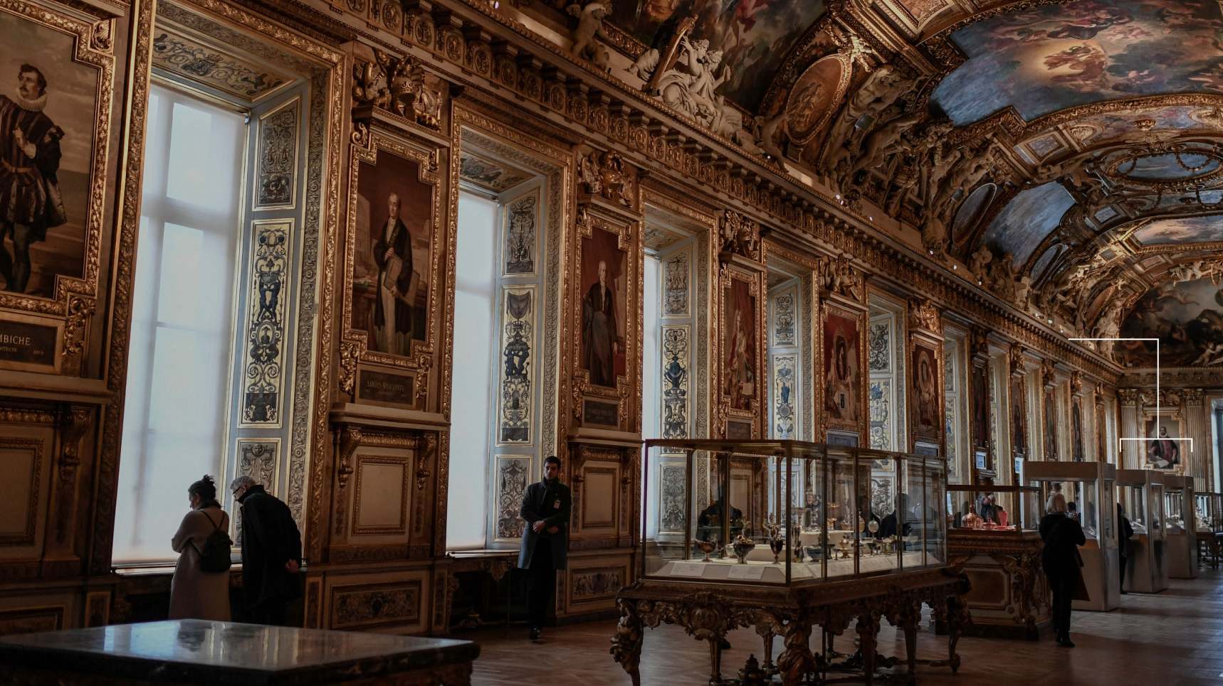
The Louvre Heist
Faris Sajjad
BS-AvM
F25

Slide 2

Table of contents
1) Title slide
2) A summary of events
3) The target
4) Chronological timeline
5) Exact items stolen
6) How they did it: methods & tools
7) Investigation progress & arrests
8) Media coverage and public perception
9) Sources & further reading

Slide 3
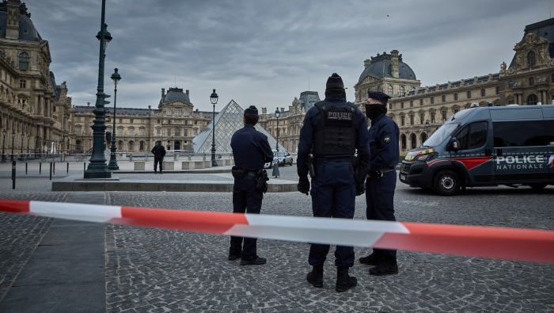
A Summary of events
What: Armed/technical burglary at the Louvre’s Galerie d’Apollon; eight historic crown-jewel items stolen (one crown later recovered, damaged).
When: Morning of 19 October 2025, ~9:30 a.m., during public opening hours.
How long: The operation took under eight minutes (roughly 4 minutes inside the museum).
Estimated value: Authorities estimated ~€88 million.

Slide 4

The target
Location: Galerie d’Apollon (Denon wing, 1st floor) — historic room that houses the French crown jewels (tiaras, crowns, historic sets).
Significance: Objects span 18th–19th centuries (Napoleonic and royal jewelry); cultural and historical value far outweighs resale price
Galerie d’Apollon & the French Crown Jewels

Slide 5
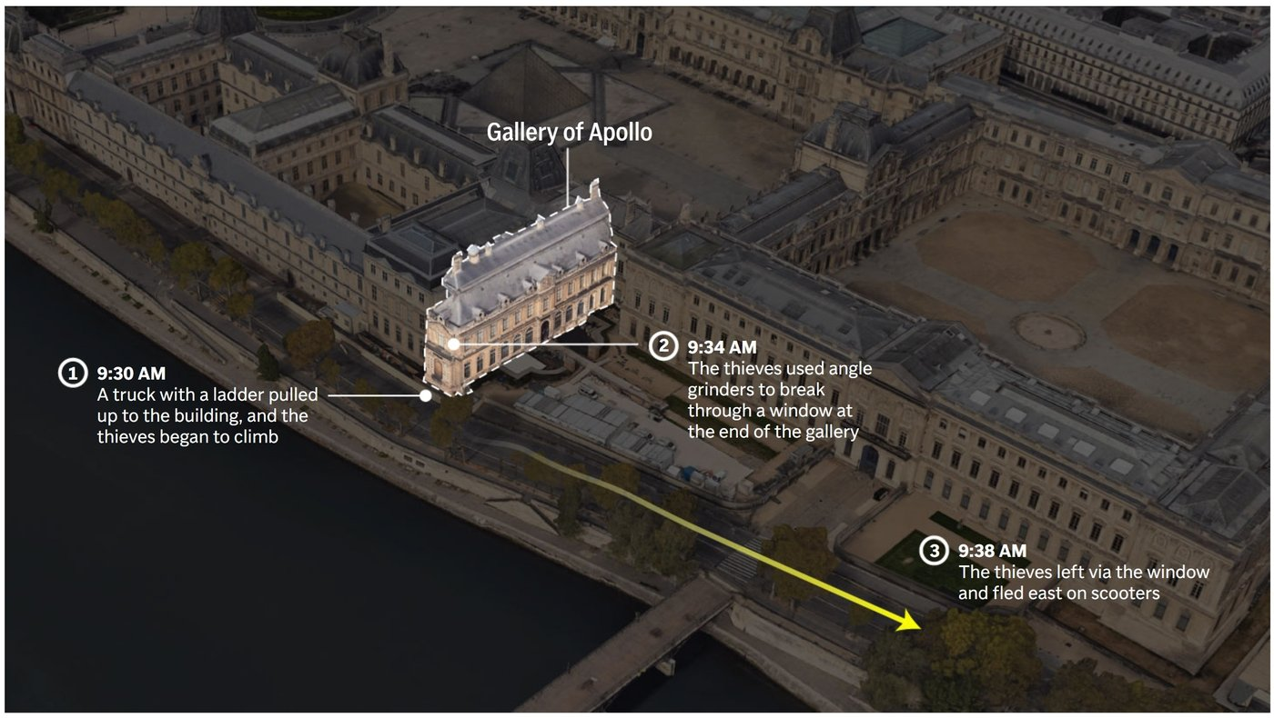
Chronological Timeline
1) ~09:00–09:30: Thieves arrive; museum opens at 9:00 and gallery busy with visitors.
2) ~09:30: Four suspects, disguised as workers (hi-vis vests), used a furniture lift / ladder truck to reach a first-floor window on the Seine side; they cut glass and entered.
3) Inside: Suspects used angle grinders/disc cutters to breach display cases, grabbed multiple pieces.
4) Escape: Fled via motorbikes; one crown was dropped outside and later recovered damaged.
5) Entire event <8 minutes.

Slide 6
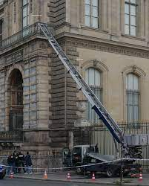
How they did it: The methods and tools behind the heist
Disguise: Hi-vis construction/maintenance vests to avoid immediate suspicion.
Access equipment: A furniture lift / ladder truck parked next to façade used to reach a window; manufacturers later went viral for their machine’s capabilities.
Tools used: Angle grinders/disc cutters to cut glass; equipment and garments left behind provided forensic leads.
Exit: Quick motorcycle getaway, planned route out along Seine then onto the ring road.

Slide 7
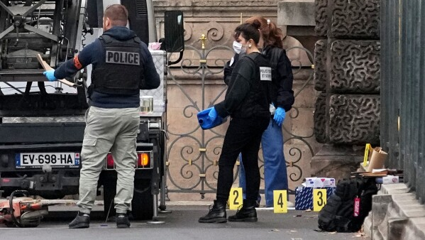
Investigation progress and arrests
Forensics: Tools, clothing and CCTV used to identify suspects.
Arrests: Two men (around 30s) arrested near Paris (one at CDG airport attempting to fly to Algeria; another in Seine-Saint-Denis reportedly planning to travel to Mali). Arrests announced late October 2025.
No public confirmation that all pieces have been recovered.
Reaction: Prosecutor criticized premature public disclosure of arrests during ongoing investigation.

Slide 8
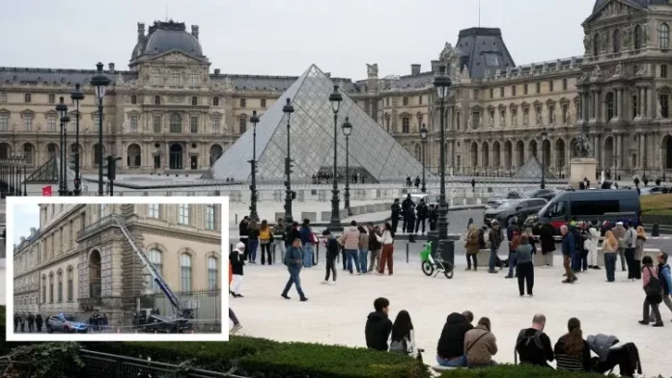
Media coverage and public perception
Headlines: Global news outlets framed it as a symbol of institutional vulnerability; social media amplified images of the lift and getaway
Reaction: The company that made the furniture lift posted a spoof ad that went viral, thus creating PR controversy

Slide 9
Sources of the material used in the presentation
Reuters — timeline, item list and arrests. Reuters+1
AP — scene, cultural reaction, and investigation. AP News
The Guardian — visual reconstruction and security critique. The Guardian
Reuters (Bank of France transfer) — post-heist measures. Reuters
Louvre / Galerie d’Apollon (official pages) — context on the gallery & jewels.

Slide 10
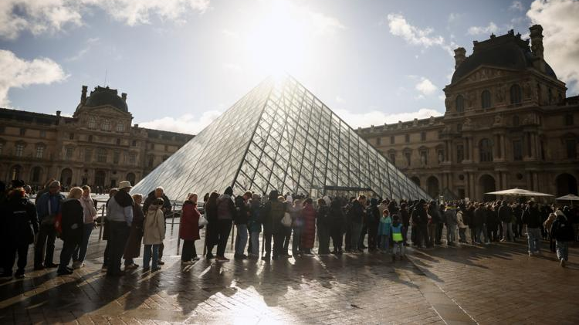
The Legacy of the Louvre Heist
The 2025 Louvre Heist is more than a crime, it’s a reminder of how fragile our shared heritage is.
It sparked global conversations about the value of art, security, and the tension between accessibility and preservation.
What was stolen were jewels, but what was truly endangered was history itself.
The question remains: How do we protect beauty without imprisoning it?

